Slide 1

Movies & Shows
Notes:
Good evening, everyone. Today, I'm going to present to you an analysis of the "Netflix TV Shows and Movies" dataset, which offers a comprehensive look at the wide range of titles available on the popular streaming platform and contains important information about various TV shows and movies available on Netflix.

Slide 2
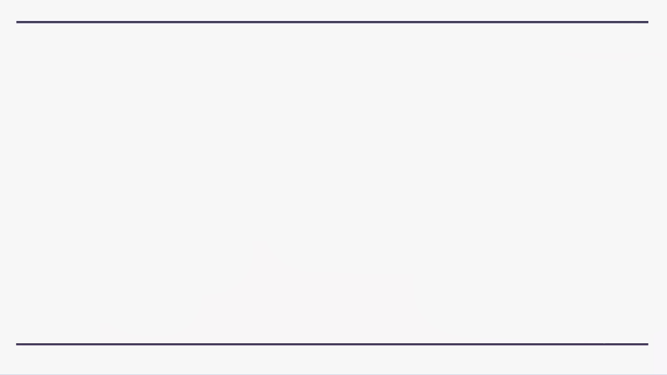
Introduction to Dataset:
The "Netflix TV Shows and Movies" dataset is a comprehensive collection of information about various titles available on the popular streaming platform.
Data Source:
Kaggle: https://www.kaggle.com/datasets
Purpose of the analysis:
Analyze the distribution of IMDB scores and ratings for TV shows and movies on Netflix to identify trends and patterns in audience preferences
Understanding viewer ratings to provide valuable insights for content creators and streaming platforms to enhance user experience.
Examining the age certification ratings to analyze the target audience for different TV shows and movies on Netflix
Comparing IMDB scores and votes across different release years can provide insights into how the quality of content on Netflix has evolved over time
Notes:
Our goal with this analysis is to understand what Netflix viewers like by analyzing IMDb scores and ratings for TV shows and movies. This helps creators and platforms know what people enjoy watching. We'll also look at the age ratings to see who watches different types of shows and movies.
Also, we will compare scores and votes overtime to show how Netflix content has changed.
Understanding these patterns helps make shows and movies better, so they match what viewers like. Overall, our analysis of Netflix data gives important insights into what people like to watch, who watches it, and how content quality has changed over time.

Slide 3
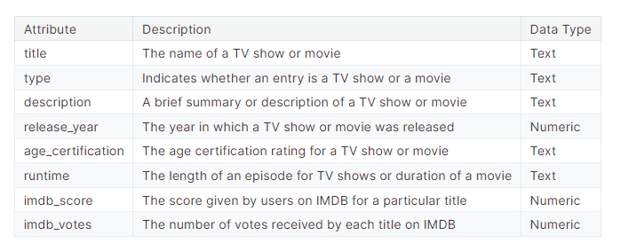
Data Understanding
The dataset includes details such as the title's name, its type (whether it is a TV show or a movie), a brief description of the content, the year it was released, age certification rating, runtime (for TV shows: length of episodes; for movies: duration), IMDb score, and IMDb votes.
There are total of 5283 entries in the dataset; and 5237 unique titles.
Notes:
This dataset includes important information such as the title, type (TV show or movie), brief description, release year, age rating, runtime, IMDb score, and votes. With over 5,200 (five thousand two hundred) items and unique titles, it provides valuable insights into viewer preferences and Netflix's content strategy.

Slide 4
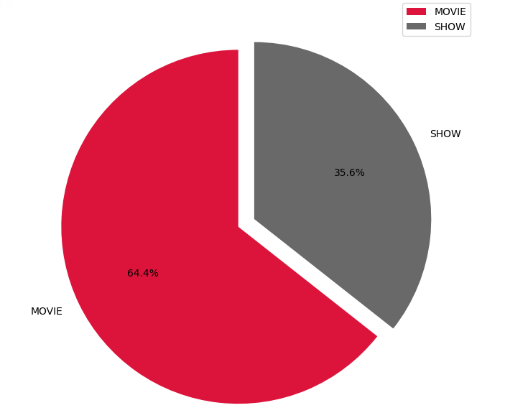
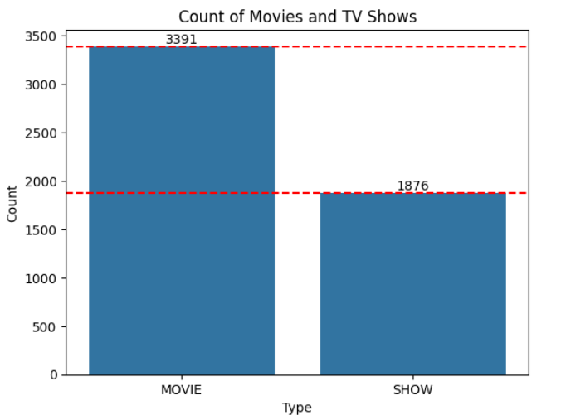
Distribution by Type
Movies are more prevalent than shows on Netflix.There are around 3391 movies while number of TV shows is 1876. The plot clearly shows that the number of shows is almost half of the number of movies.
Notes:
Netflix has way more movies than shows 3391 (three thousand three hundred ninety-one) movies, and only 1876 (one thousand eight hundred seventy-six) TV shows indicating a strong focus on providing subscribers with a variety of movie choices.

Slide 5
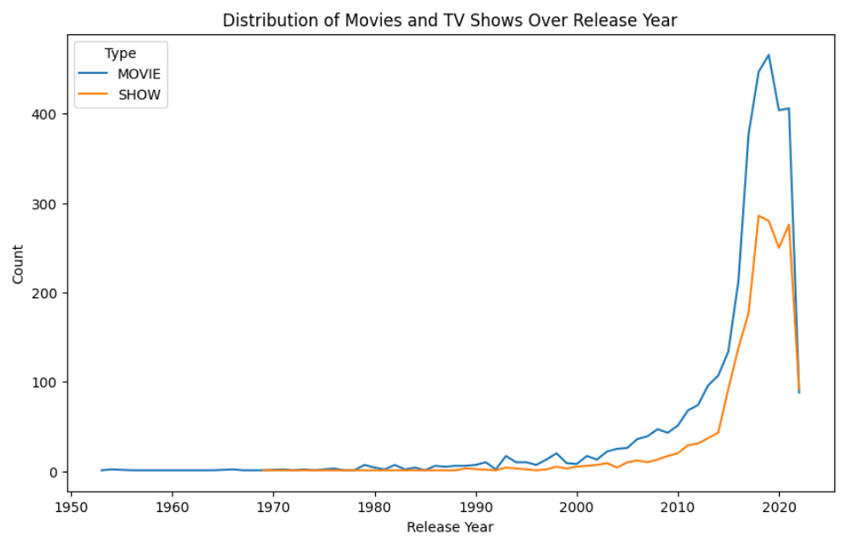
Distribution of Movies and Tv Shows Over release year
The surge in movie and show releases, from one per year to as many as 180 now, points to a booming entertainment industry. This growth reflects how technology has evolved, making it easier for filmmakers and producers to create content since 1953.
Notes:
The increase in movie and show releases indicate that the entertainment world is growing. This is because new technology has made it easier and more creative to make content

Slide 6
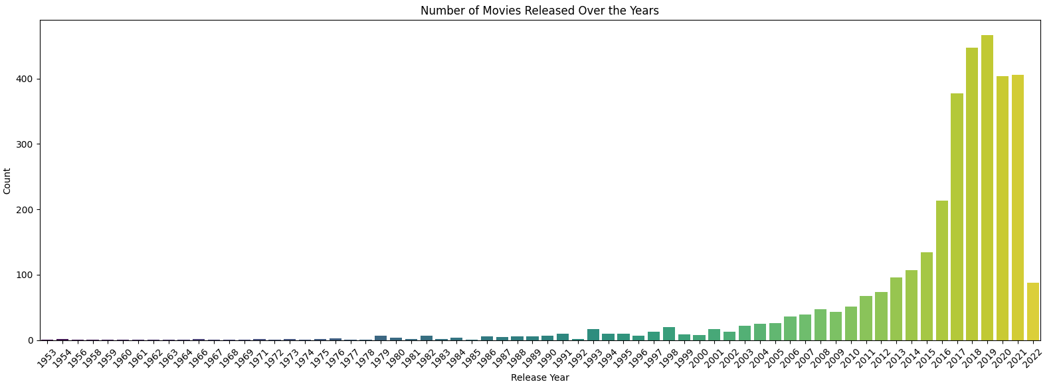
Notably, from 2018 to 2021, the count of movie releases surpassed the 400 mark, reaching a peak in 2019
Notes:
From 2018 to 2021, there were over 400 movie releases each year, with a peak in 2019. Similarly, the most TV show releases occurred in 2018 ( Next slide)

Slide 7
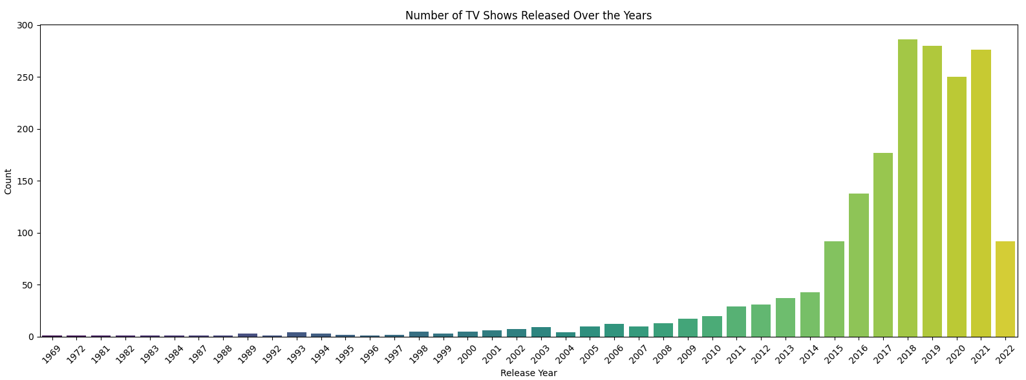
The peak of Tv shows occurs in 2018, followed by notable peaks in 2019 and 2021
Notes:
There were notable peaks in 2019 and 2021, reflecting significant investments in TV show production and a wide range of content available to viewers.

Slide 8
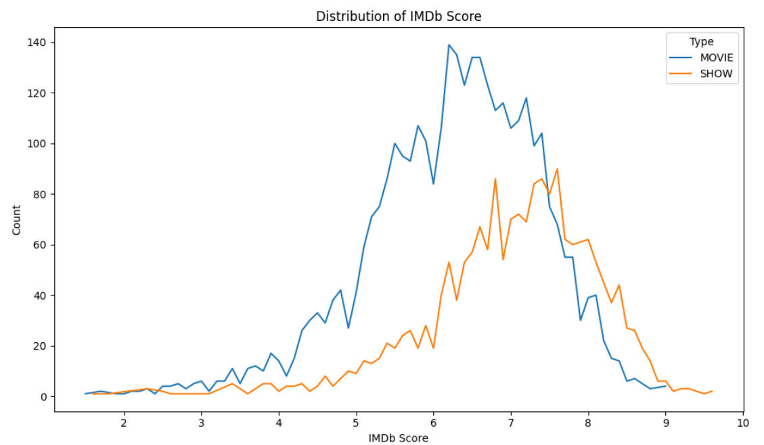
IMDb Distribution Analysis
it becomes evident that IMDb tends to assign a score of 6.6 most frequently to films, and the average rating stands at 6.5. This suggests a common trend in IMDb ratings for movies.
Notes:
Analyzing the IMDb distribution, we find that the most frequent score assigned to films is 6.6, with an average rating of 6.5.

Slide 9
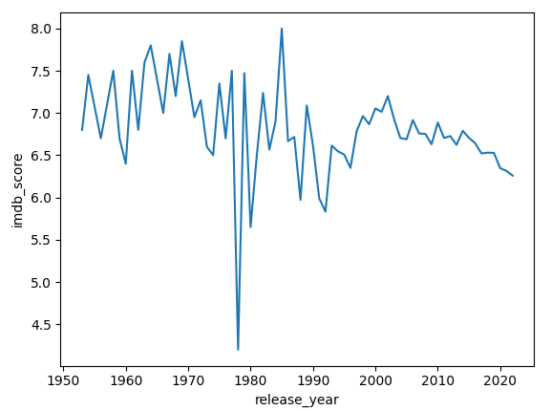
Analyzing how IMDb scores have changed over the years
The released in earlier years tend to exhibit higher IMDb scores.
A notable and consistent decline in IMDb scores is observed annually.
Between the 1970s and 1980s there is a sharp decrease in the scores with averages dropping below 4.5.
The period between the 1980s and 1990s, a significant uptick in the average scores is notable, reaching nearly 8.0. The unique phase where the average scores peaked.
Notes:
IMDb scores have varied over the years, with notable declines in the 1970s and 1980s, followed by a peak in the 1980s and 1990s.

Slide 10
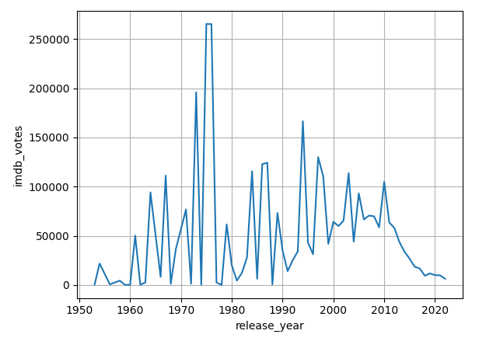
Analyzing how IMDb votes have changed over the years
Significant growth of users voting to a movie/show titles over the year.
The peak vote, is at more than 250,000 votes between the year 1970s and 1980s.
Significant ups and downs of users voting from between 1950s until 1990s, and
more kind of stable voting trend after 1990
Notes:
IMDb votes have increased steadily (STED-lee) over time, with more people voting for movies and shows each year.

Slide 11
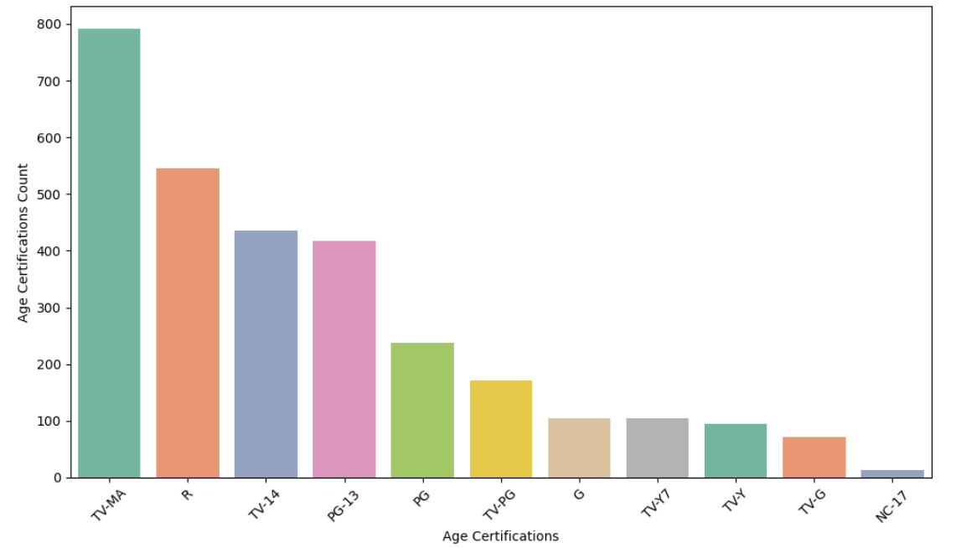
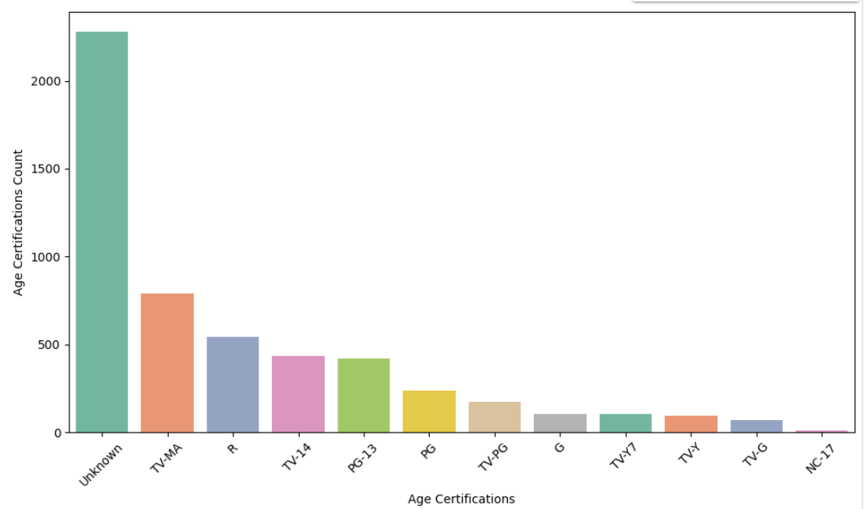
2. Age certification Analysis
We have 12 different type of age
The number of non null values on age_certification column is: 2278
The number of non values on age_certification column is: 2989
"Unknown" is the most common age certification compared to others. This indicates that there is a significant number of films and shows that either haven't been assigned or haven't acquired age certifications.
TV-MA stands as the second-highest age certification. Subsequently, PG-13 and TV-14 follow in terms of frequency.
Explanation of different type of age certifications :
'R' = Adults(+18) 'PG' = Older Kids (+7) 'TV-14' = Young Adults (+16) 'G' = Kids (All) 'PG-13' = Teens(+13) 'TV-MA' = Adults(+18) 'TV-PG' = Local Rating Values 'TV-Y' = Kids (All) 'TV-G' = Kids (All) 'TV-Y7' = Older Kids (+7) 'NC-17' = Adults(+18)
Notes:
Age certification ratings indicate that "Unknown" is the most common, followed by TV mature audiences. This suggests a need for a clear age ratings for Netflix content.

Slide 12
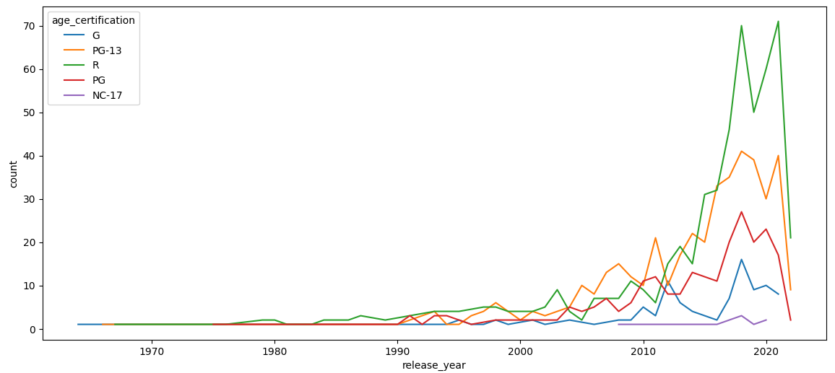
The prevalence of TV-MA, PG-13, and TV-14 certifications indicates a diversity in age-appropriate content within the dataset.
Explanation of different type of age certifications :
'R' = Adults(+18)
TV-MA' = Adults(+18)
'PG' = Older Kids (+7)
'TV-14' = Young Adults
(+16) 'G' = Kids (All)
'PG-13' = Teens(+13)
'TV-PG' = Local Rating Values
'TV-Y' = Kids (All)
'TV-G' = Kids (All)
'TV-Y7' = Older Kids (+7)
'NC-17' = Adults(+18)
Notes:
As you can see in the explanation of different type of age certification added, there are more than one value for the same age group. I collect these values by age group and ( Next slide)

Slide 13
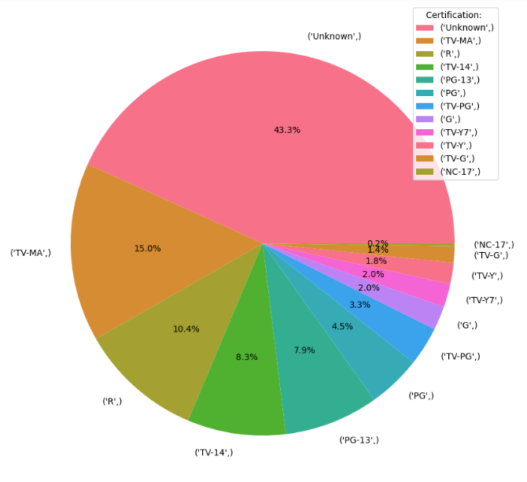
What is the percentage distribution of different age certifications?
Explanation of different type of age certifications :
'R' = Adults(+18)
TV-MA' = Adults(+18)
'PG' = Older Kids (+7)
'TV-14' = Young Adults
(+16) 'G' = Kids (All)
'PG-13' = Teens(+13)
'TV-PG' = Local Rating Values
'TV-Y' = Kids (All)
'TV-G' = Kids (All)
'TV-Y7' = Older Kids (+7)
'NC-17' = Adults(+18)

Slide 14
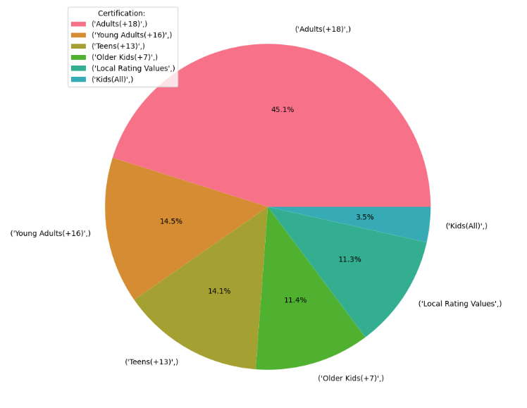
What is the percentage distribution of different age certifications?
45.1% of for Netflix content is for adults +18
3.5 % of Netflix content is for kids
Notes:
A significant portion of Netflix content (45.1%) is purposed for adults aged 18 and above, while only 3.5% is purposed for kids.

Slide 15
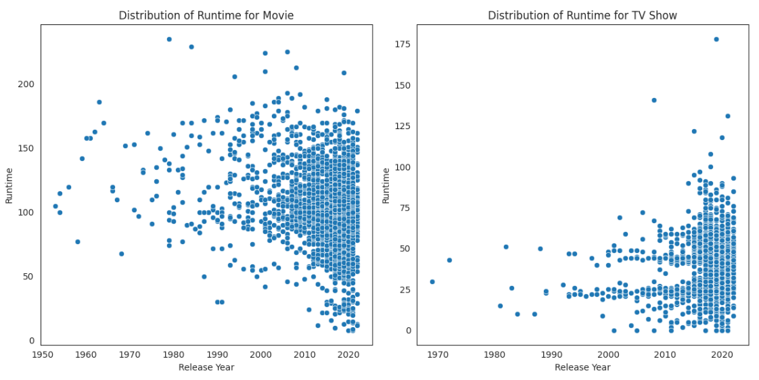
3. Runtime Analysis
While movies dominate in terms of overall runtime due to their individual length, TV shows offer a distinct viewing experience with shorter episodes and a more episodic structure.
Notes:
Analyzing runtime trends, we find that movies have longer runtimes compared to TV shows, reflecting different storytelling formats.

Slide 16
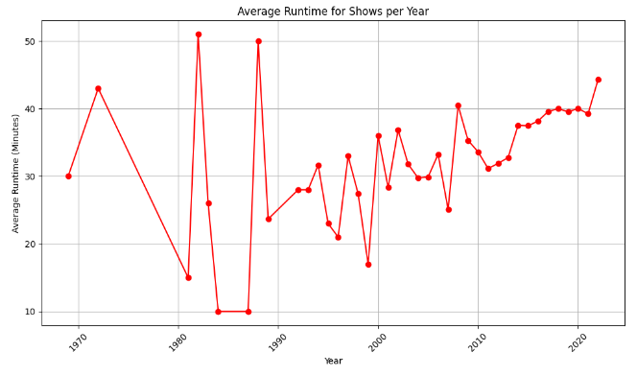
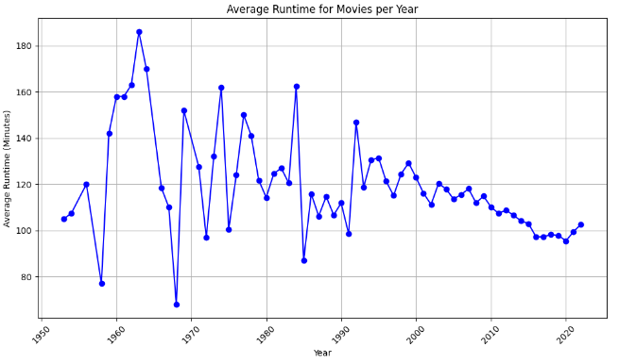
Over time, there has been an observable trend where the average runtime of TV shows has shown a steady increase, contrasting with a gradual decline in the average runtime of movies.
Average Runtime for Show: 39 Minutes or 0.65 Hours
Overall runtime: 101.81
Average Runtime for Movie: 102 Minutes or 1.7 Hours
Overall runtime: 38.63
Notes:
Over time, the average runtime for TV shows has increased, while the average runtime for movies has declined.

Slide 17


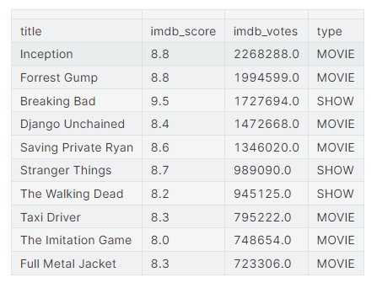

4. Top 10 Rated
Top-rated TV shows and movies based on IMDb scores and votes
Top-Rated Titles:
"Breaking Bad" stands out with the highest IMDb score of 9.5, making it the top-rated entry in the table.
"Inception" and "Forrest Gump" share the second-highest score of 8.8, making them equally highly-rated.
IMDb Scores:
The IMDb scores in the table range from 8.0 to 9.5, indicating a selection of high-quality content.
The average IMDb score is relatively high, with the majority of titles scoring above 8.0.
Notes:
Top-rated titles on IMDb include "Breaking Bad," "Inception," and "Forrest Gump," with scores ranging from 8.0 to 9.5.

Slide 18
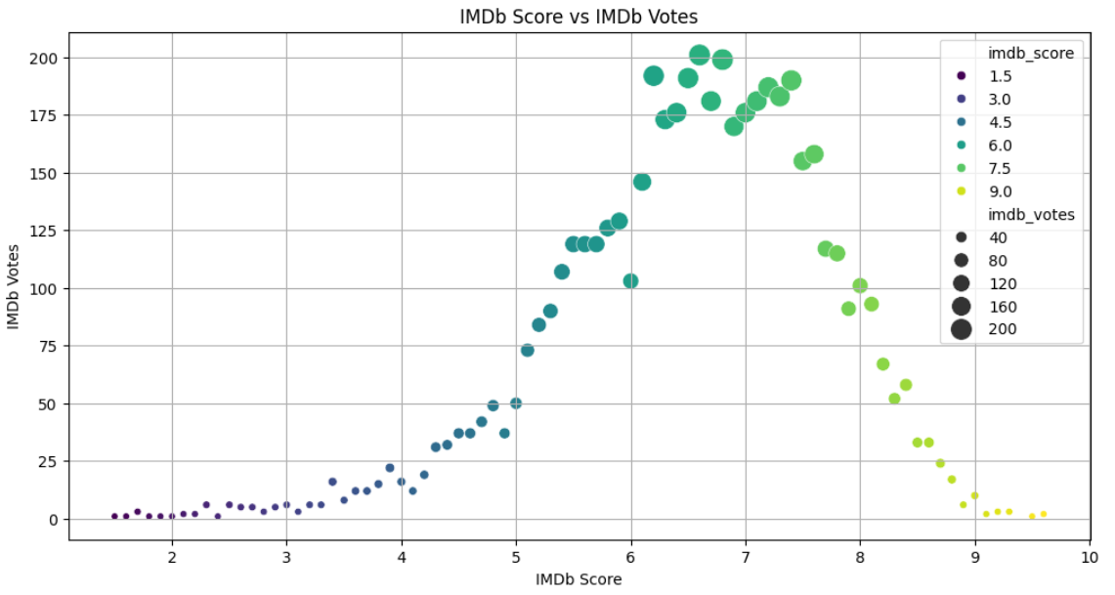
Imdb_score Vs Imdb_votes
To understand if highly-rated content also tends to receive more votes
Overall, the visualization provides a useful overview of the relationship between IMDb score and IMDb votes.
Movies and shows with higher IMDb scores tend to have more IMDb votes. This is likely because people are more likely to vote for movies and shows that they enjoyed.
There are some movies and shows with high IMDb scores but relatively few IMDb votes, and vice versa. This is likely due to a number of factors, such as the genre of the movie or show, the marketing budget, and the release date.
Notes:
Our visualization shows a correlation between IMDb score and votes, indicating that higher-rated titles tend to have more votes.

Slide 19
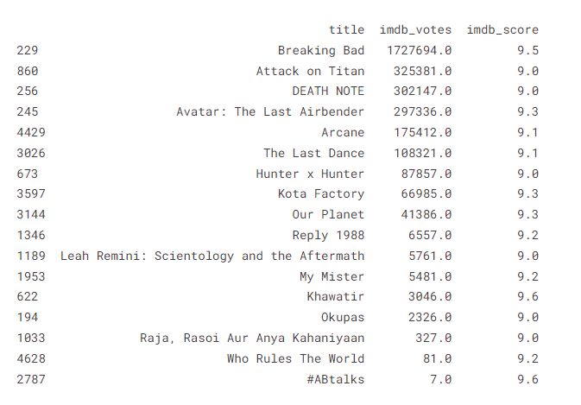

Filter movies with an IMDb score higher than 9 and more than 10,000 votes
There are many movies with an IMDB score higher than 9 but the total number of votes is less than 10000. The shows Raja, Rasoi Aur Anya Kahaniyaan, Who Rules The World, and #ABtalks have very high IMDB scores, but their IMDB ratings are very few.
So IMDB scores alone cannot give an idea about the quality of a movie.
Notes:
When filtering movies with high IMDb scores and votes, we find cases where movies have high scores but few votes, highlighting the importance of considering both factors.

Slide 20
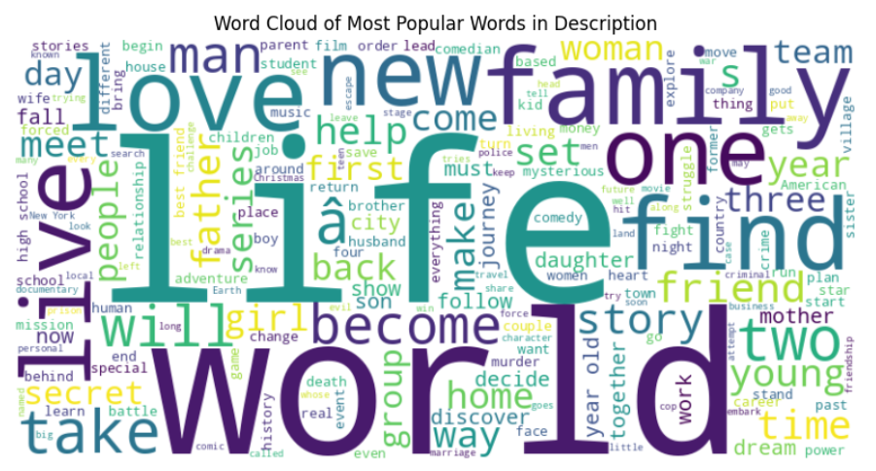
5. Text Analysis
The most common words in the descriptions are "love", "family", "new", "young", and "life".
The most used word in Netflix movie description is the word "life". This suggests that Netflix movies often focus on themes of love, family, new beginnings, and youth.
Notes:
In addition to IMDb scores and votes, our analysis of text descriptions displays common topics like "love," "family," and "life" in Netflix content.

Slide 21
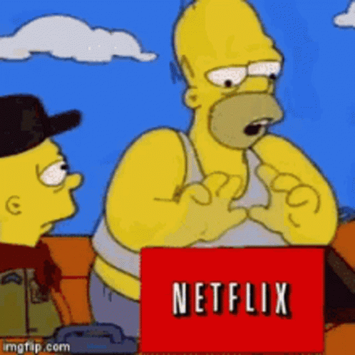
SUMMARY:
69.78% of content on Netflix consists of movies, while 30.22% are TV shows
'Rajiv Chilaka' has released the highest number of shows
The highest number of shows was added in the year 2019.
IMDB scores alone cannot give an idea about the quality of a movie.
The importance of addressing and assigning appropriate certifications to maintain clarity and suitability for different audiences
The most used word in Netflix movie description is the word "life".
Netflix movies often focus on themes of love, family, new beginnings, and youth.
NEXT:
From where Netflix's products come from?
Top 10 Genres of Movies
Top 10 Genres of Tv Shows
To perform this step, we need to use another dataset to support.
Notes:
In conclusion, our analysis provides valuable insights into audience preferences, content quality, and trends in the entertainment industry. Moving forward, we plan to investigate Netflix's content sources and explore top movie and TV show genders.

Slide 22

THE END! THANKS FOR WATCHING!!
Notes:
This is all , thank you

